Slide 1
Prediction parameters

Slide 2
Multi-task learning architecture
[draw architecture]

Slide 3
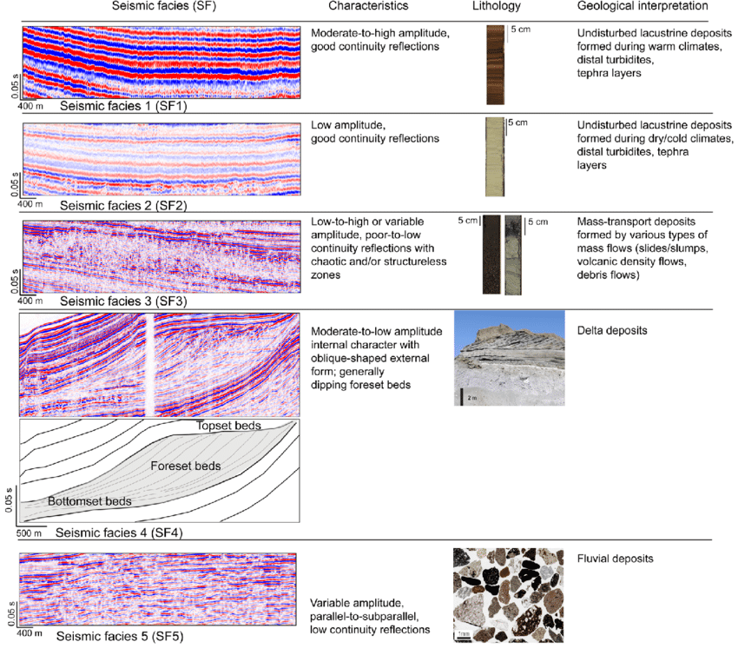



Reasonable basis for prediction ex: Coeff of uniformity
$$C_{u}=lower$$
Humus content high
$$C_{u}=lower$$
Humus content low
$$C_{u}=higher$$
Etc..
Etc.
This human / geological skill uses natural «image recognition». Must make the case that there is a basis for prediction here.

Slide 4
Geological evaluation
The geological experience, which normally is not thought quantifiable, is here what is being quantified
Higher order relationships in the data

Slide 5

Design parameters
$q_{c}, f_{s}, u, w$
Where there are no direct links, there may still be statistical correlations of higher order.

Slide 6
Classification

